Slide 1
Spaceship Titanic
Project Report
Presented by
Arman Mahmoodzadeh
Daniel Herrera
Jose Mateo Ayala
Leonardo Granados-Castillo

Slide 2
Content
1
Team Responsibilities
2
Project Description
3
Dataset Description
4
Tools and Environment
5
Methods, Algorithms, Model Performance Comparison
6
Final Results & Conclusions

Slide 3
Team Responsibilities
All Four Members – Random Forest Model
Arman
Responsibilities:
Integrate best feature-engineered datasets from both teams
Train and tune Random Forest ensemble
Conduct hyperparameter search (n_estimators, max_depth, etc.)
Analyze feature importance
Compare performance with baseline models
Generate final predictions and interpret results
Team Lead
Leo and Jose
Arman and Daniel
Pair B – Decision Tree Team
Responsibilities:
Prepare tree-friendly data (label encoding, missing-value strategies)
Train and tune Decision Tree models of different depths
Visualize tree structure
Analyze patterns in top-level splits
Evaluate performance with accuracy, ROC, and AUC
Pair A – Logistic Regression Team
Responsibilities:
Conduct preprocessing and encode categorical variables
Scale numerical features
Build baseline Logistic Regression model
Tune hyperparameters
Analyze model coefficients
Generate ROC curve and AUC score
Full Name
Title
Full Name
Full Name
Title
Title
Full Name
Title

Slide 4
Tools & Environment
All analysis and development were completed using:
Python 3.x
Jupyter Notebook
NumPy
pandas
matplotlib & seaborn
scikit-learn (sklearn)
Graphviz (Decision Tree visualization)

Slide 5

Our project focuses on predicting whether the passengers on the Spaceship Titanic were transported to another dimension after a spacetime anomaly. Using the Kaggle dataset, our goal is to build a machine-learning model that predicts the “transported” status of each passenger based on various data. We will clean and prepare the data, create useful features, and test different machine-learning models. Overall, our goal is to build an accurate prediction model that can be used reliably. Our goal has been to clean and explore data, understand features, missing values, distributions, and correlations. We wanted to transform raw features into ones that are more useful for modelling and build one or more models. Then, evaluate the model's performance, use it to generate predictions, and learn from the results.
Each model was trained, tuned, and evaluated, and the final results were compared using accuracy, ROC curves, and AUC metrics. The project concludes by selecting the best-performing model for deployment.
Project Description

Slide 6
Dataset
The Spaceship Titanic dataset is provided by Kaggle and includes demographic, travel, and spending information for passengers aboard the ship.
Train Dataset
Contains all features plus the target variable Transported.
Test Dataset
Contains all features minus the target label; used to generate model predictions.
Target Variable
Transported
Boolean value
True → Passenger was transported to another dimension
False → Passenger remained in normal space
Rank in the industry

Slide 7
Dataset
Feature | Type | Description
PassengerId | Object | Unique passenger identifier
HomePlanet | Categorical | Planet of origin
CryoSleep | Boolean | Whether the passenger opted for cryosleep
Cabin | Object | Location encoded as Deck/Number/Side
Destination | Categorical | Destination of the passenger
Age | Numeric | Passenger age
VIP | Boolean | Whether the passenger is VIP
RoomService, FoodCourt, ShoppingMall, Spa, VRDeck | Numeric | Onboard spending categories
Transported | Boolean | Target label

Slide 8
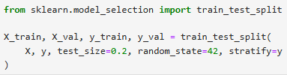
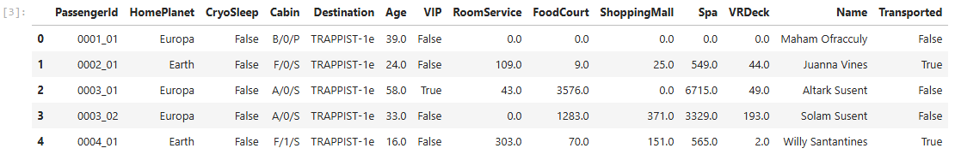
Methods and Algorithms
The project used three main supervised learning algorithms.
Each model was trained using the same training/validation split:
Loaded Data: (sample of raw dataset that was entered, reading train.csv and test.csv and storing them as pandas DataFrames)

Slide 9
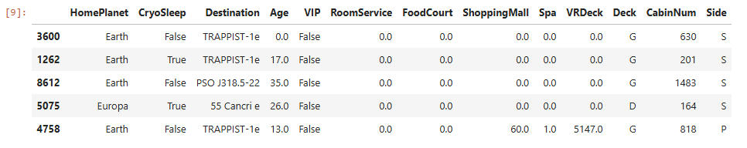
Processed data
To process the data we did the following in order to prepare the data so that machine learning models can understand it:
Split the Cabin column into Deck, Cabin Number, and Side
Identified numeric and categorical columns
Filled missing numeric values with the median
Filled missing categorical values with the mode (most common value)
Ensured consistent data types to avoid warnings
Removed irrelevant columns (Name, Cabin, PassengerId)
Split data into training and validation sets (80/20 split)

Slide 10
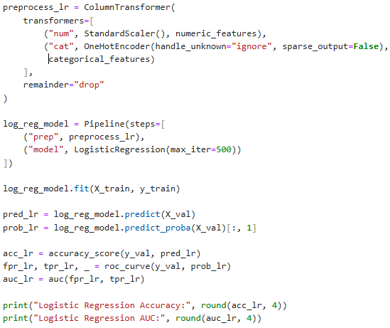
Logistic Regression Model
Using this model we:
Created a preprocessing pipeline that:
Scales numeric values
One-hot encoding categorical values
Fit a Logistic Regression classifier
Made predictions on the validation set
Calculated Accuracy, ROC Curve, and AUC score
Results:
Logistic Regression Accuracy: 0.7918
Logistic Regression AUC: 0.8815

Slide 11
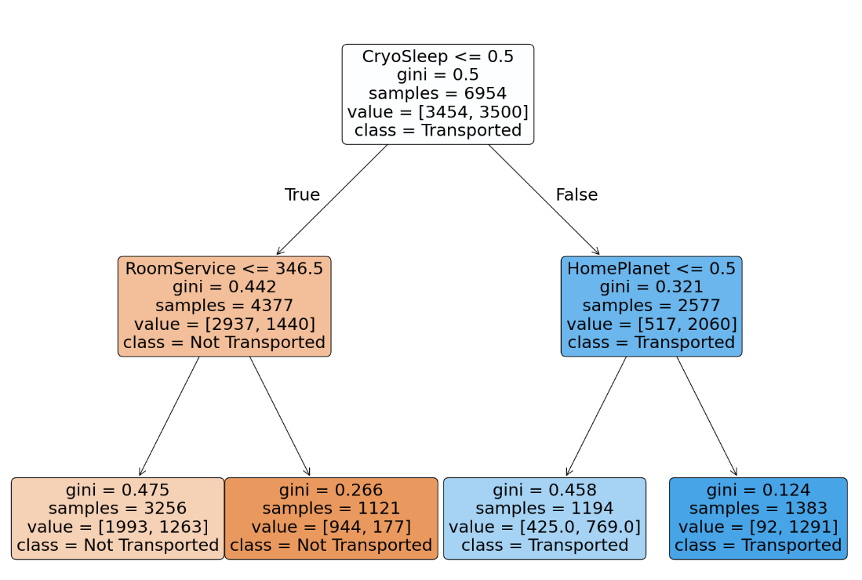
Decision Tree Model
Goal - Build and evaluate a Decision Tree Classifier to predict whether a passenger was transported or not.
The decision tree was one of the models used for this project because it is easy to interpret, fast at training, and can work well with multiple different feature types such as boolean, numeric, categorical, object.
We made sure to convert boolean values into strings and Label Encoded all categorical columns.
Train/Test split (80/20)

Slide 12
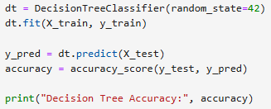
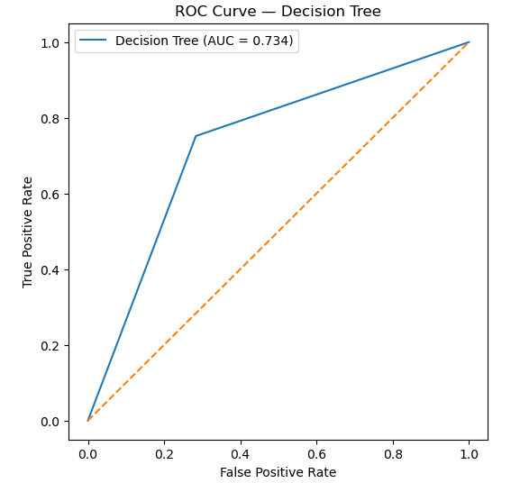
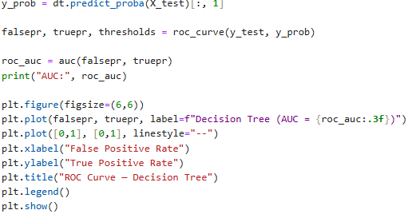
Decision Tree Results
DecisionTreeClassifier(random_state=42)
Accuracy of Decision Tree model: 0.7343300747556066. (Estimate = .73)
Area under the curve (AUC) Score: 0.7341585114516943. (Estimate = .73)
Receiver-operating characteristic curve (ROC):

Slide 13
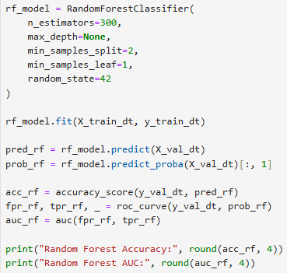
Random Forest Model
Using this model we:
Trained a Random Forest Classifier using the same encoded dataset
Combined many decision trees to improve accuracy
Made predictions and computed Accuracy, ROC, and AUC
Results:
Random Forest Accuracy: 0.8085
Random Forest AUC: 0.8931

Slide 14

Models
MODEL PERFORMANCE SUMMARY
Logistic Regression: Accuracy=0.792, AUC=0.881
Decision Tree: Accuracy=0.784, AUC=0.859
Random Forest: Accuracy=0.809, AUC=0.893

Slide 15
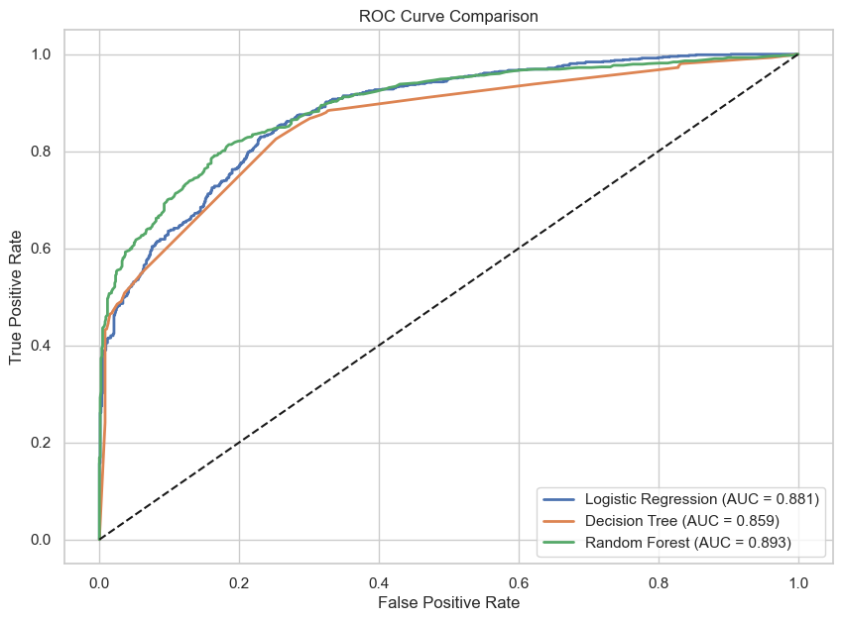
ROC Curve Comparison
CROSS-VALIDATION SCORES
Logistic Regression CV Accuracy: 0.7872
Decision Tree CV Accuracy: 0.759
Random Forest CV Accuracy: 0.7851

Slide 16
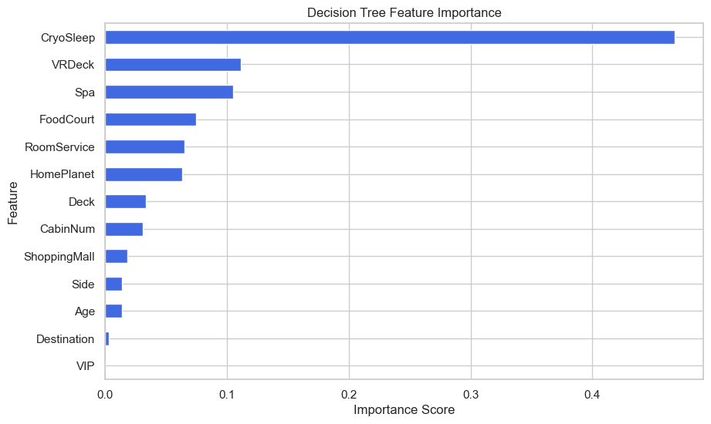
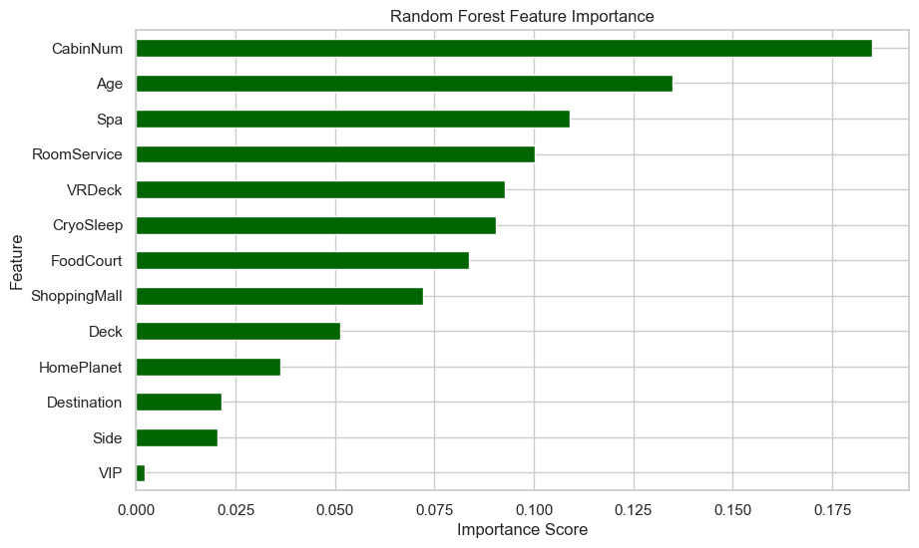
Feature Importance Plots

Slide 17

Logistic Regression
Decision Tree
Model impressions
Random Forest
Accuracy=0.79
AUC=0.881
Accuracy=0.78
AUC=0.859
Excellent baseline
Indicates your preprocessing (scaling + encoding) worked well
Logistic regression often performs surprisingly well here
AUC 0.881 means the model separates classes effectively
Slightly lower accuracy, which is normal
Trees overfit easier unless tuned heavily
AUC 0.859 is good for a single-tree model
Confirms that non-linear splits help, but not as much as you need
Accuracy=0.8
AUC=0.893
Best accuracy
Best AUC
Combines many trees → reduces overfitting

Slide 18
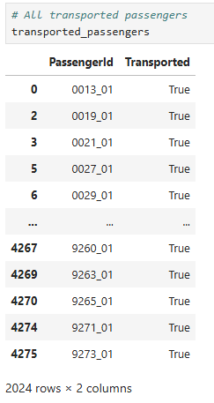
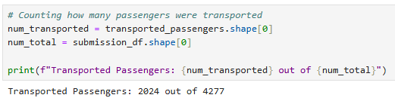
Results
Transported Passengers: 2024 out of 4277

Slide 19
Thank you

